Slide 1
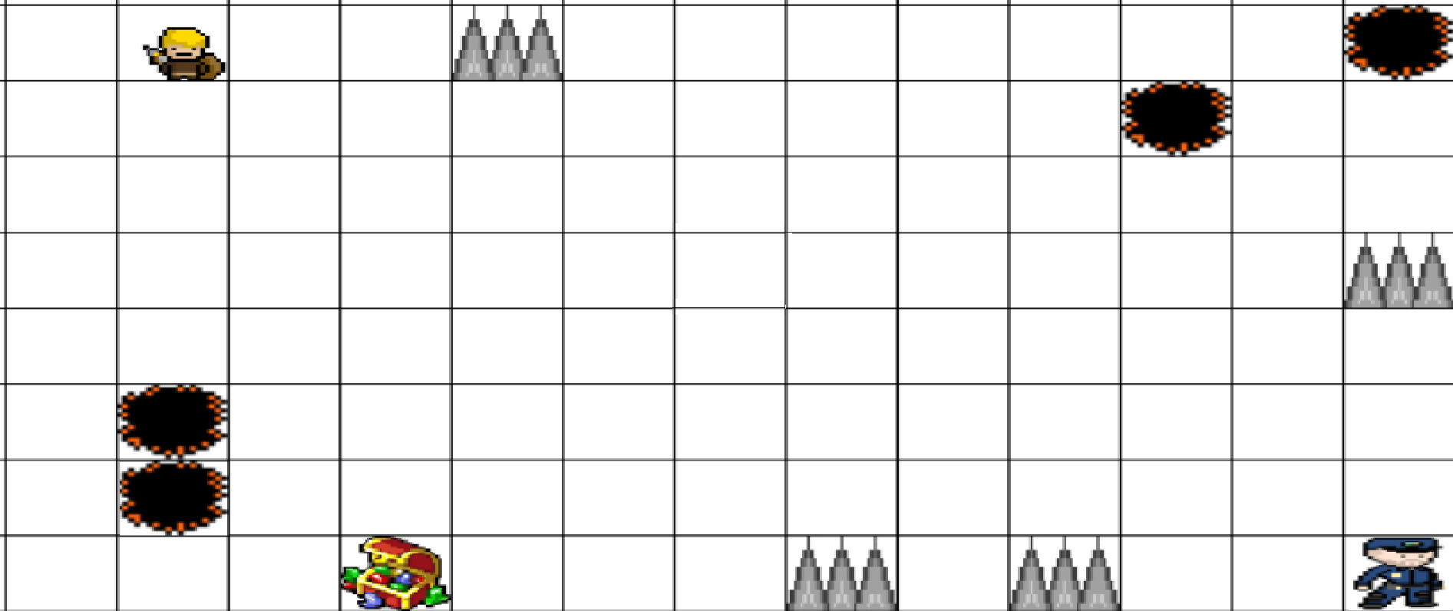
PREVENT THIEVERY GAME
USING Q-LEARNING
MAHMUT ALPEREN ÇAVUŞ 210408044

Slide 2
BASIC EXPLANATION
This code is a pygame-based implementation of a grid-world environment where an agent navigates the grid to find a key and a chest while avoiding hazards like spikes, holes, and a guard. The agent uses Q-learning to improve its navigation strategy over time.

Slide 3
DETAILED EXPLANATION
There is an agent that is trained with q-learning, in a grid world there is a chest and a key, and the agent needs to get the key first and then go to the chest. If agent tries to go the chest first without a key, the chest will not be open and agent will not be able to get the diamond.After agent gets the diamond, the game ends. In this grid world, there will be spikes that kill the agent, there will be holes that also kill the agent if it falls into a one. Spike's punishment will be -500, hole's punishment will be -600. Gridworld will be 10x10(this may change). There will be a guard that chases the agent. If the agent is caught by the guard game is over, and the punishment for the getting caught by a guard is -900. The guard will chase the agent with A* algorithm without stepping on the holes and spikes. I will introduce a 30% of probability to move randomly without using A* algorithm. Every empty step cost -50 reward. The agent's aim is to collect the diamond in the chest without being caught by the guard and don't step on spikes and holes. For every iteration the agent iterates, agent saves the experience in the gridworld for the agent. When the agent fails and starts the game again, it remembers the previous experiences. This experience is stored in a json file. This project is done with pygame library. The game will have three kind of maps. First one is easy, second is moderate and the third one is hard. Logic is more difficult the map is the more traps and holes there are. The agent gets positive feedback if it gets closer to the key. The positive feedback reward for getting close to key is 100 points. If the agent has the key and it gets closer to the chest it gets a positive feedback of 200 points. This feedback helps agent to recognize the environment's dynamics better. Agent also has a 5x5 observation area. So agent knows the positions of items or guard, if they are in its observation area.

Slide 4
CODE PRESENTATION

Slide 5
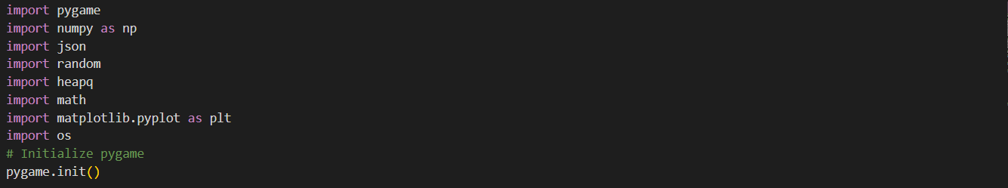
Pygame.init()-> Initializes all imported pygame modules. It must be called before using any other pygame functions.

Slide 6
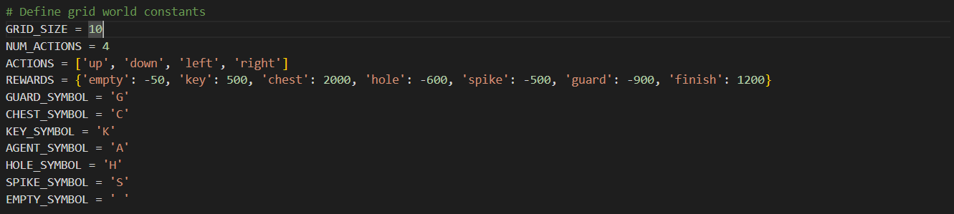
Empty -> every empty step reward. For example, if agent takes step to the block that the key is on, this is not an empty step.
Symbols are constants representing different objects in the grid world

Slide 7
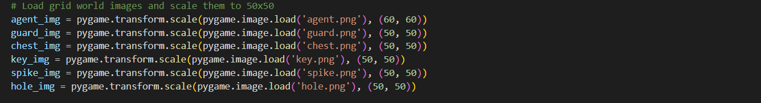
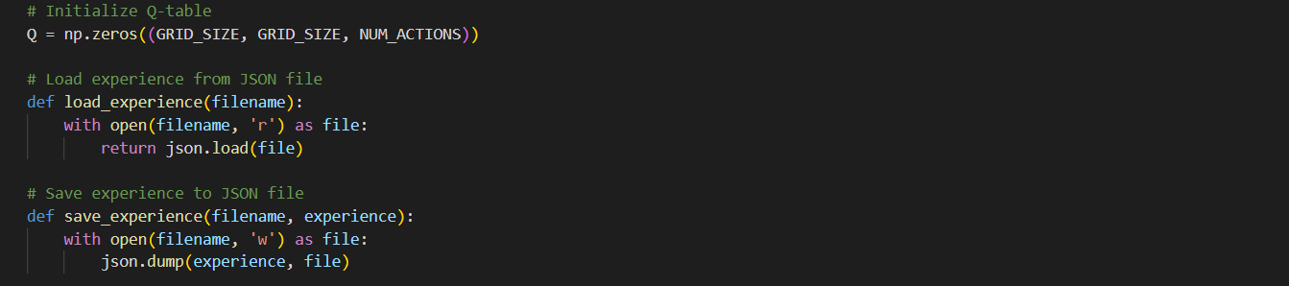
Loading and scaling the pictures for the visualization purposes.
Initializes a Q-table with zeros. The Q-table has dimensions (GRID_SIZE, GRID_SIZE, NUM_ACTIONS), where each cell corresponds to a state-action pair.
load_experience: Reads Q-table data from a JSON file.
save_experience: Writes Q-table data to a JSON file.

Slide 8
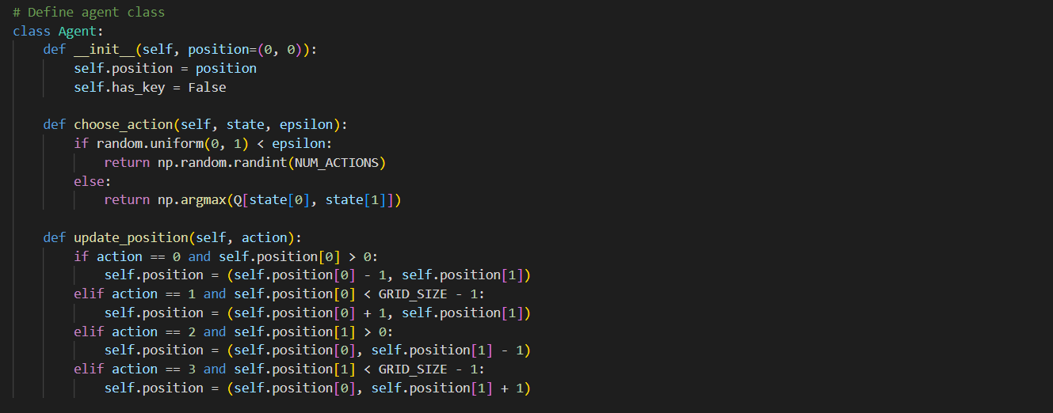
choose_action: Chooses an action based on epsilon-greedy policy. With probability epsilon, it selects a random action; otherwise, it selects the action with the highest Q-value.
update_position: Updates the agent’s position based on the action taken, ensuring it stays within grid bounds.

Slide 9
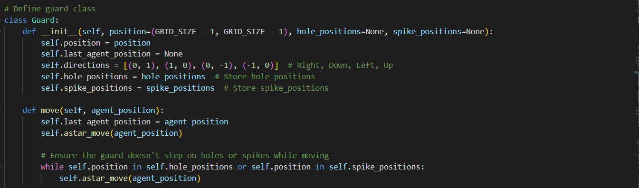
move: Moves the guard towards the agent using A* algorithm and ensures it doesn't step on holes or spikes.

Slide 10
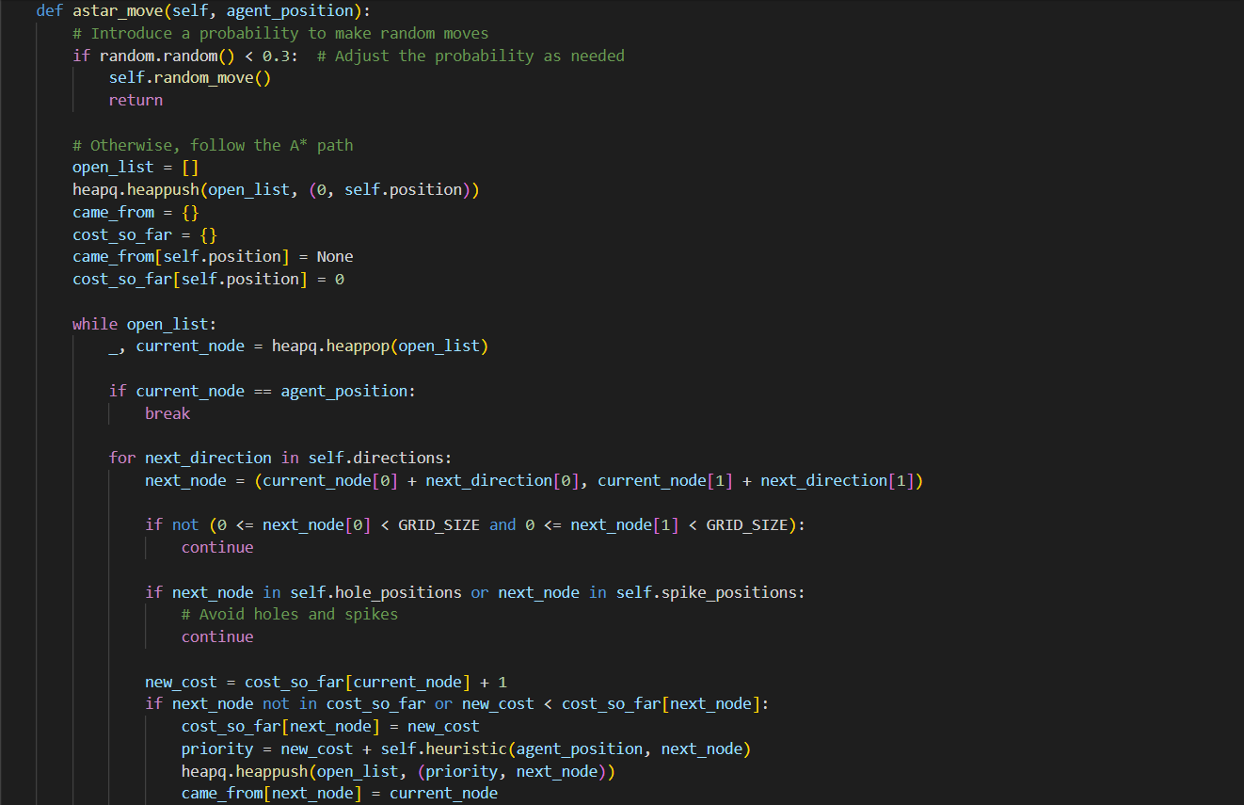

Slide 11
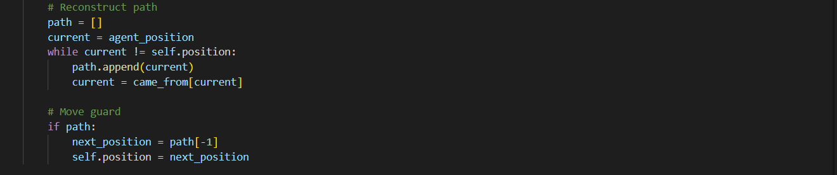
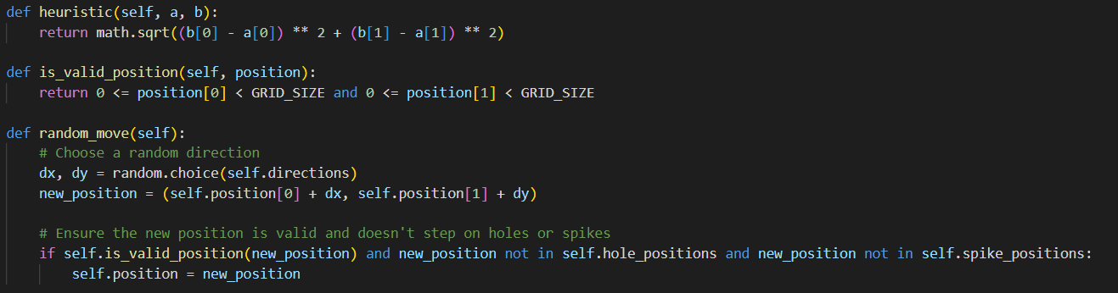
astar_move: The previous code snippet and this snippet, implements the A* algorithm to move towards the agent, with a chance of random movement in order to ease the job of our agent. Otherwise, the guard would be overpowered.
heuristic: Calculates the Euclidean distance between two points which is used for A* algorithm.

Slide 12
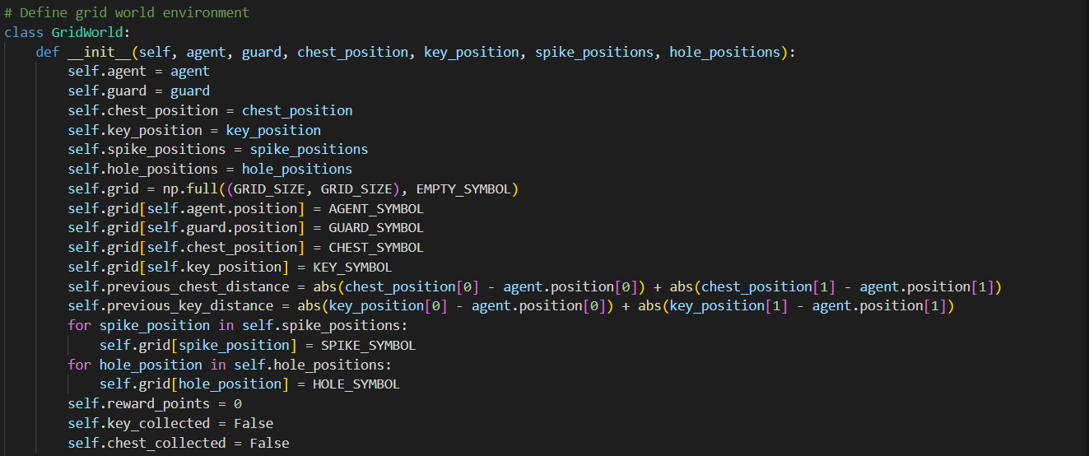
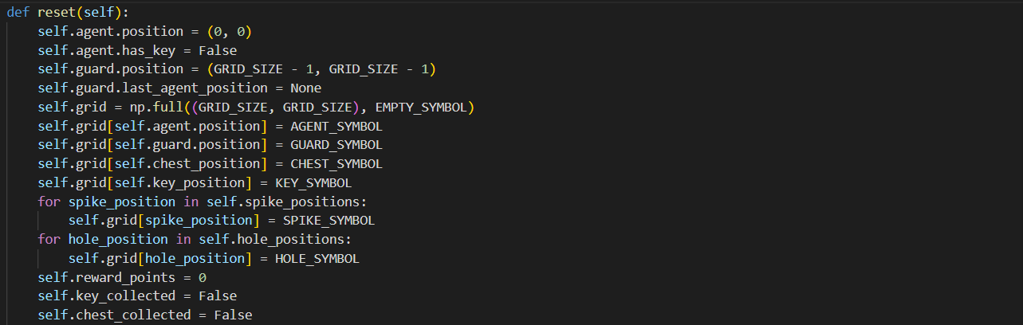
Constructor initializes the GridWorld, placing the agent, guard, chest, key, spikes, and holes in the grid.
reset: Resets the grid to the initial state.

Slide 13
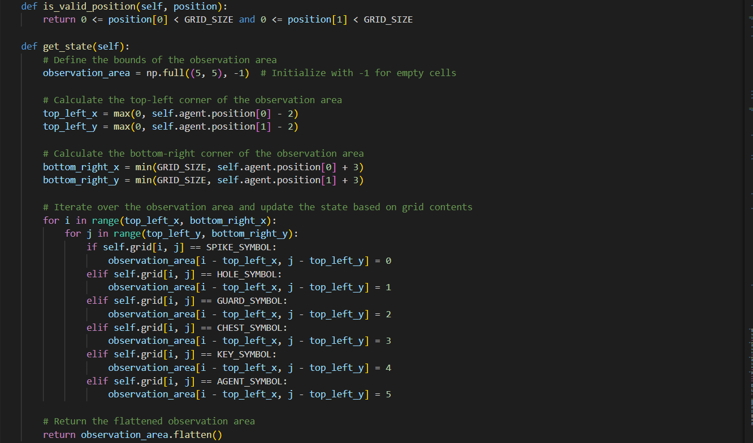

Slide 14
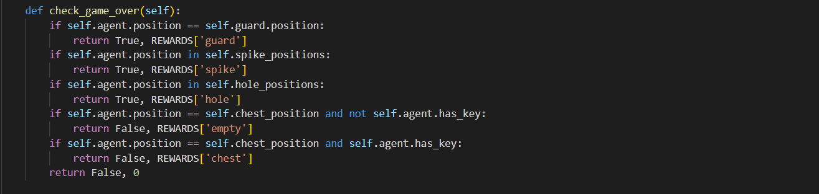
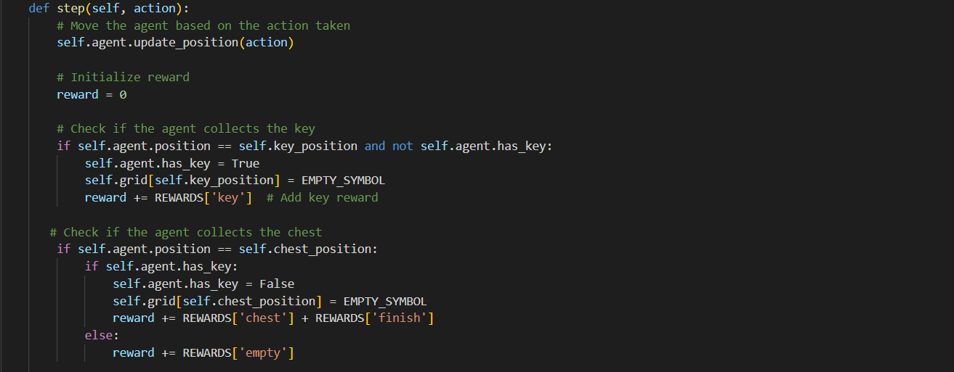
get_state: Used for observation area. Observation area is 5x5. Agent knows if the items or the guard is in its observation area.
check_game_over: Checks if the game is over and returns the reward for the agent depending on the game over type.

Slide 15
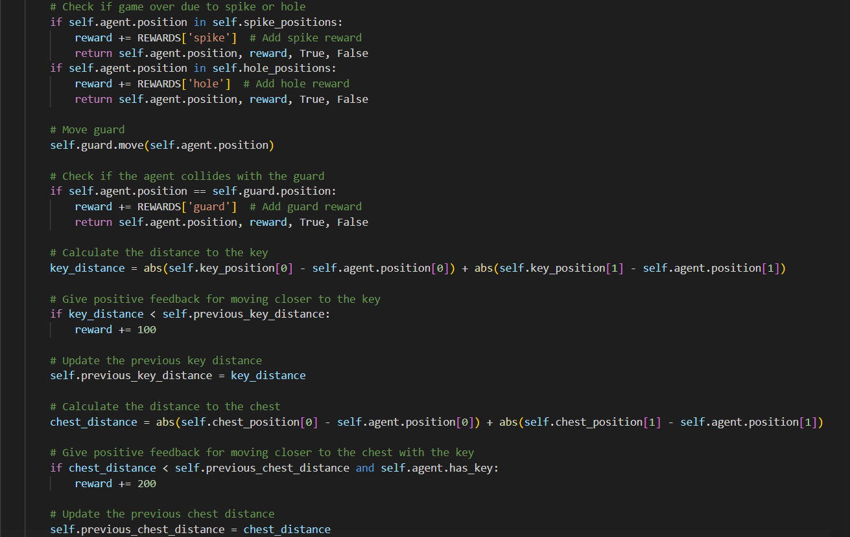

Slide 16
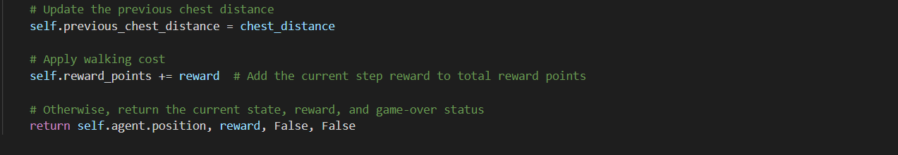
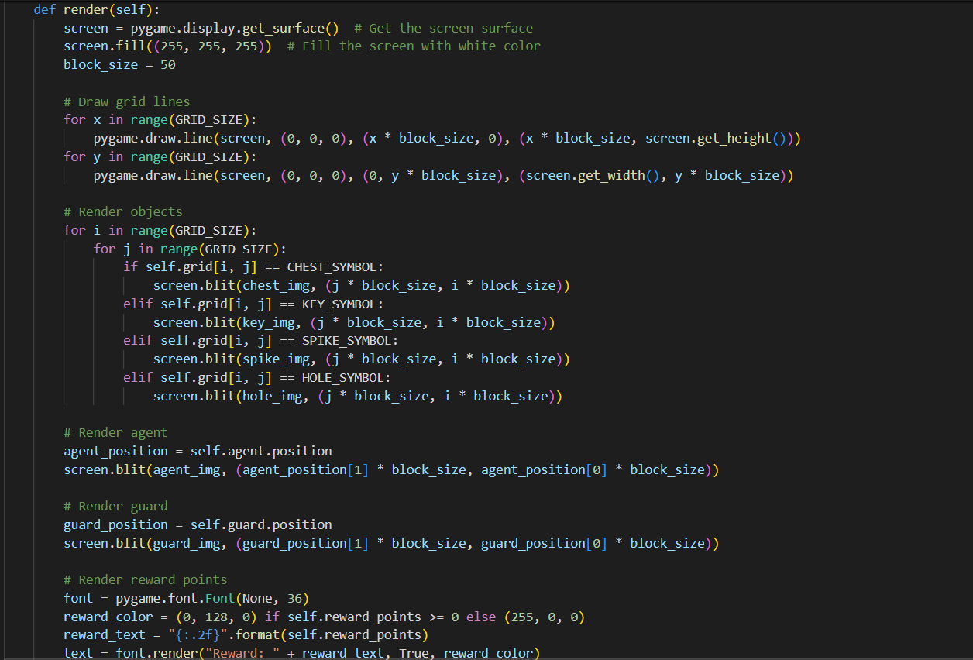
step: Executes an action, updates positions, computes rewards, and checks for termination.

Slide 17
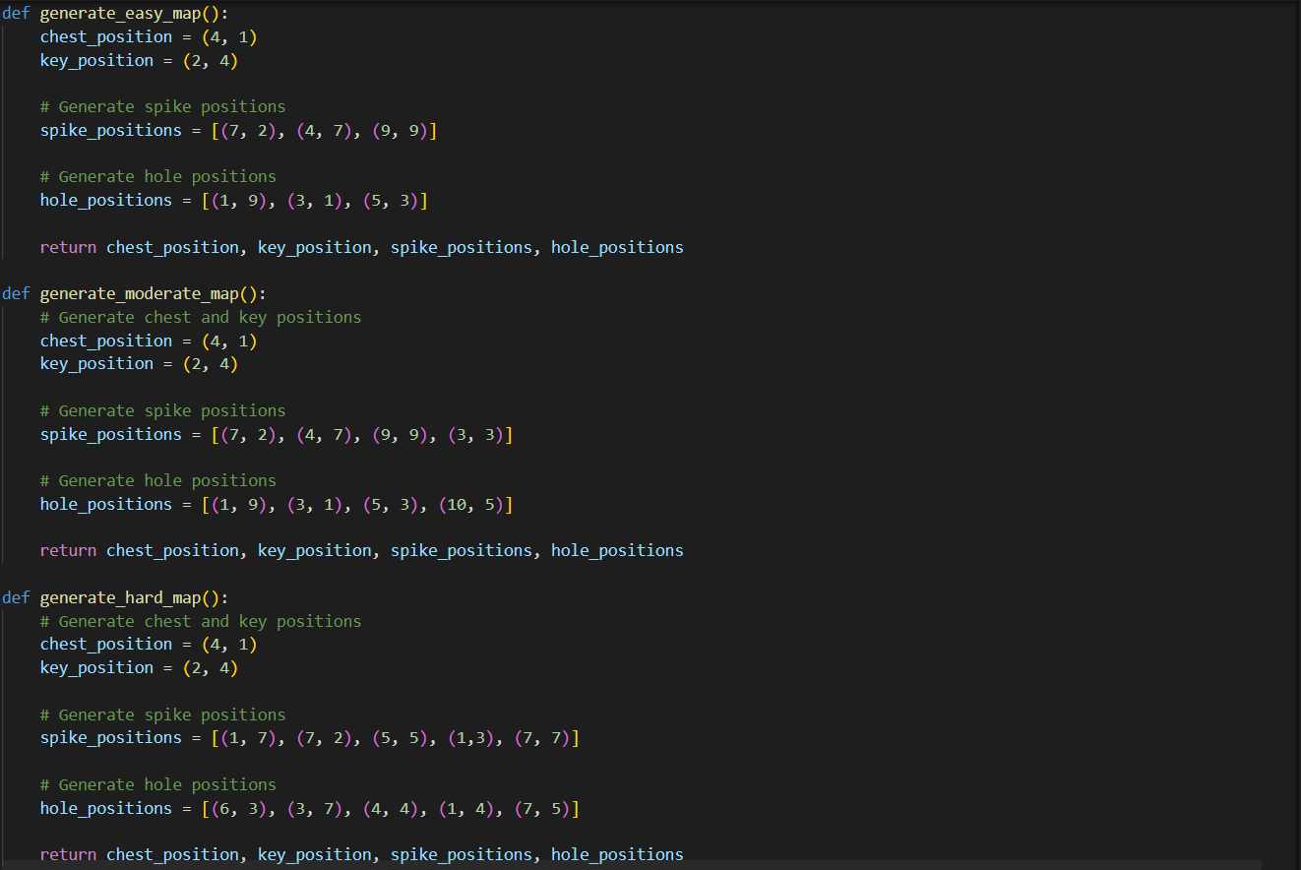
render: Renders the current grid state using pygame.

Slide 18
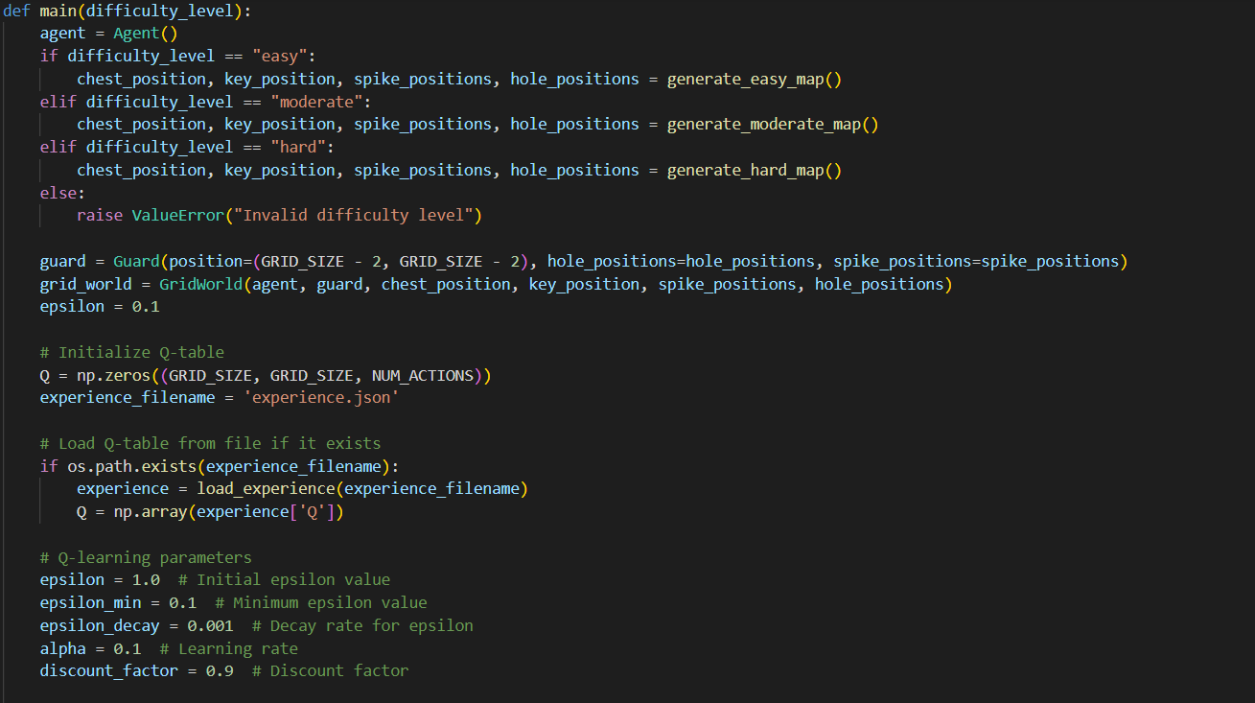
generate_easy_map, generate_moderate_map, generate_hard_map : Generates a gridworld, places spikes, holes, chest and key randomly while placing them, it ensures that none of them overlaps.

Slide 19
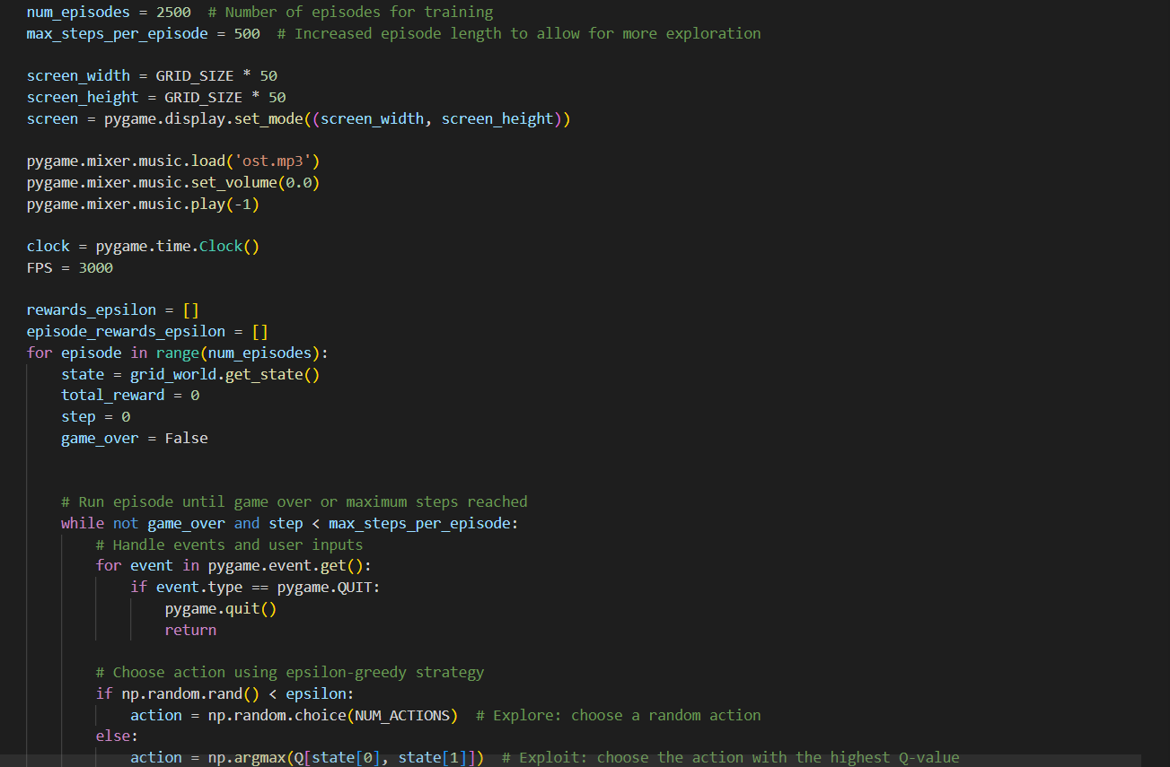

Slide 20
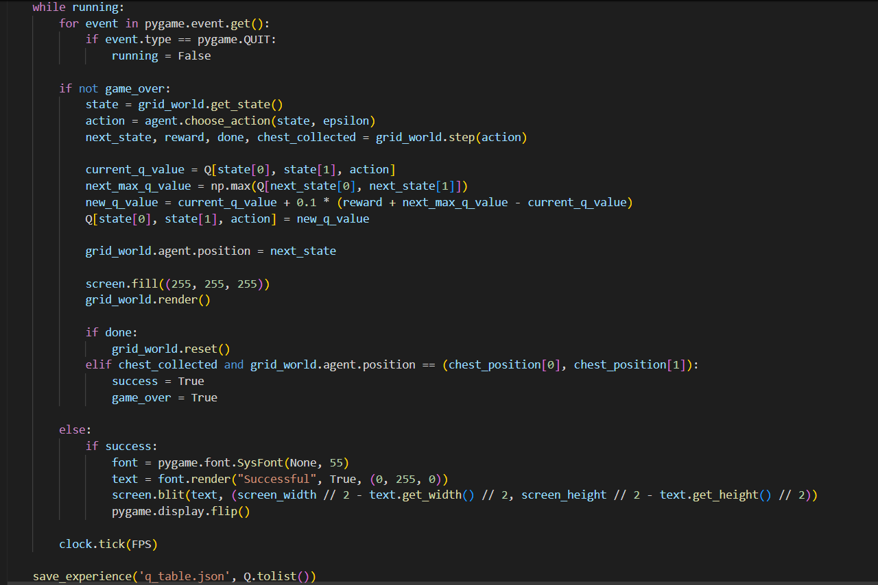

Slide 21
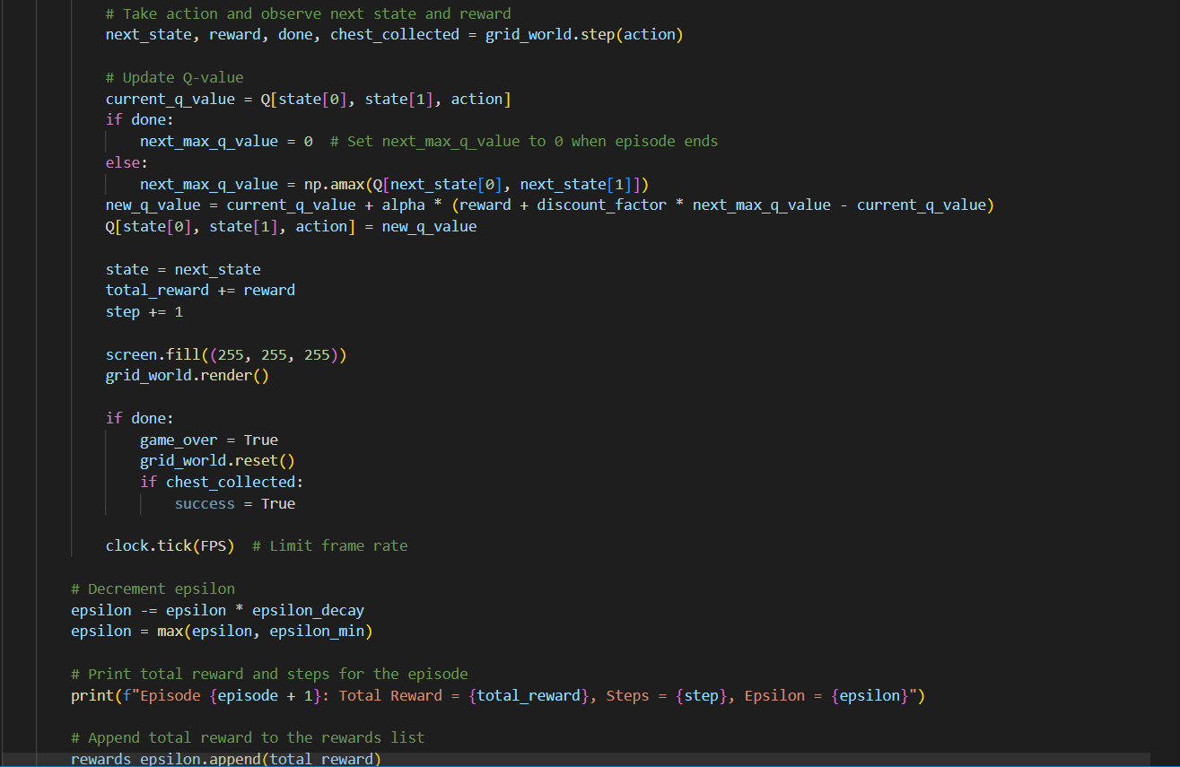

Slide 22
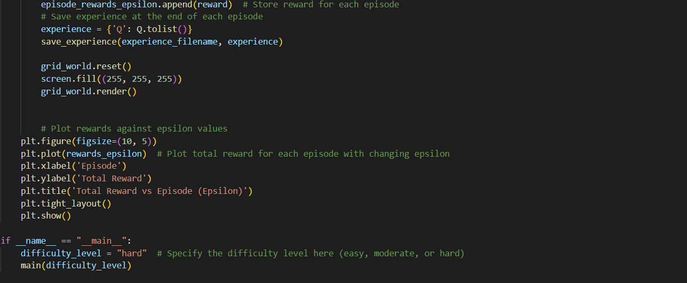
main:
epsilon: Exploration rate.
Epsilon_decay: epsilon decaying for every episode.
Alpha: Learning rate
Episode Number: Number of episodes
Training loop: Runs the training episodes, updating the Q-table based on actions, rewards, and state transitions.
Q-table update: Uses the Q-learning update rule.
save_experience: Saves the Q-table to a JSON file after training.

